Slide 1
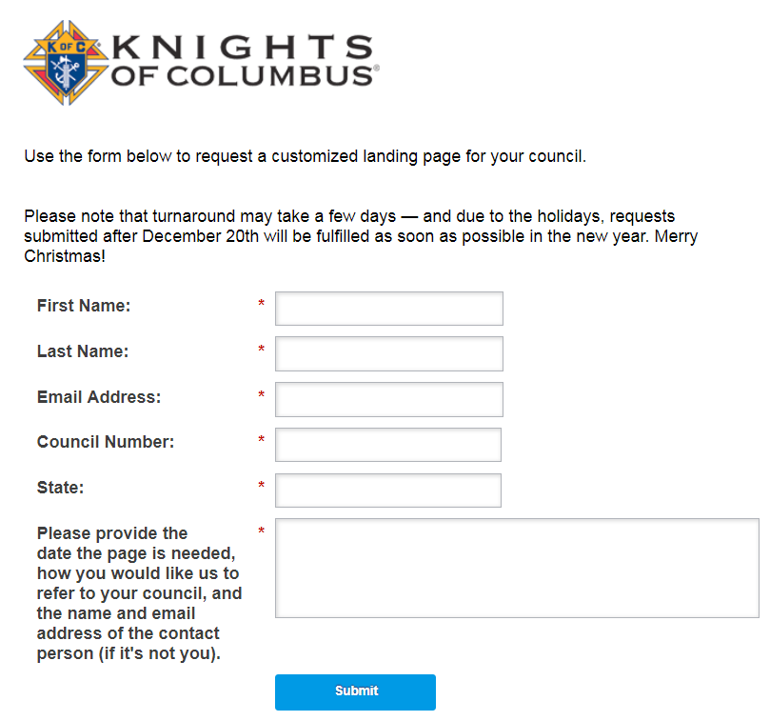
PREPARATION
Build a Prospect Landing Page
Info.kofc.org/pagerequest

Slide 2
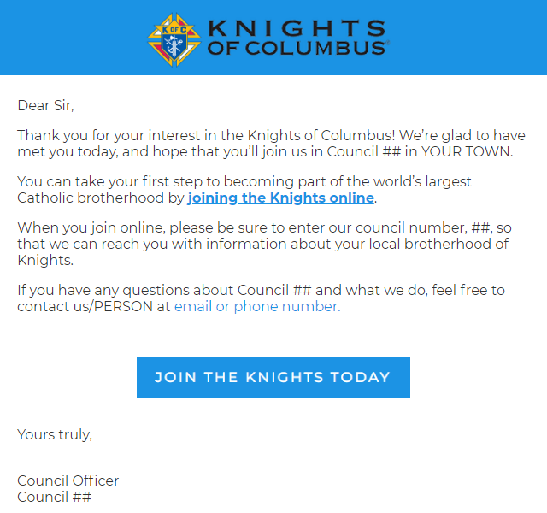
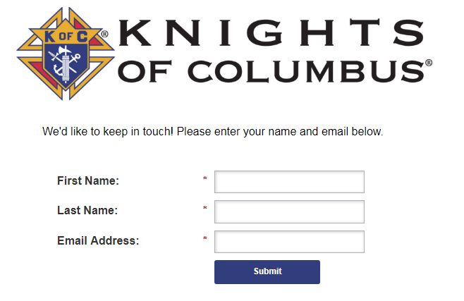
PREPARATION
Build a Prospect Landing Page
Info.kofc.org/pagerequest

